Slide 1
RDCS1 Final Presentation
Team Zoundi
Ali Arshad, Arnold Zoundi, David Szabo & Ryan Hillier

Slide 2
Project Description / Scope
RDCSI Six Stories Project
Objectives
Impact
Project Goal : Develop a WordPress Rest API
What does this include?
What does this not include?
Secondary Objectives
Usability
Efficiency
Easily Supportable
Notes:
The goal of this project was to create a Rest API for the Romeo Dallaire Child Soldiers Initiative’s (RDCSI) .

Slide 3
Project Completion Status
Initial Objective
Learn how to use WordPress CMS
Develop WP REST API
Extra Objective
Develop web pages to show proof of concept of WP functionality

Slide 4
User Stories
Proof of concept web page
Parallax effect
WP REST API calls
Custom Post Types
simple content creation
intersection functionality

Slide 5
Major Challenges
Incomplete WordPress REST API Documentation
Translating tutorials solutions to the project

Slide 6
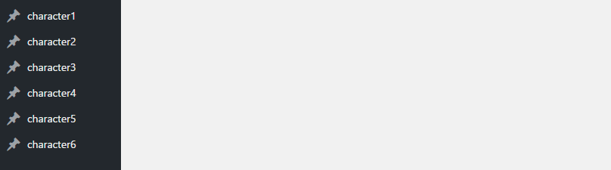
Custom Post Types
Notes:
Created by the Six Stories Plugin

Slide 7
Custom Routes / Endpoints
http://dev-sixstories.pantheonsite.io/wp-json/rest-routes/v2/ch1 for character1
http://dev-sixstories.pantheonsite.io/wp-json/rest-routes/v2/ch2 for character2
http://dev-sixstories.pantheonsite.io/wp-json/rest-routes/v2/ch3 for character3
http://dev-sixstories.pantheonsite.io/wp-json/rest-routes/v2/ch4 for character4
http://dev-sixstories.pantheonsite.io/wp-json/rest-routes/v2/ch5 for character5
http://dev-sixstories.pantheonsite.io/wp-json/rest-routes/v2/ch6 for character6
http://dev-sixstories.pantheonsite.io/wp-json/rest-routes/v2/chall for all characters
Notes:
Handled by the WP Rest Routes Plugin

Slide 8
Stories Intersection
One of the central challenges in this project was that stories can intersect and other paths can be followed
Custom Post types support this with:
Incoming Links
Outgoing Links
Conditions
Because of this configuration, a frontend developer has several options with which to build the frontend.

Slide 9
Deliverables
Website for proof of concept
Custom post types plugin
Updated custom parallax

Slide 10

Teamwork is Everything!
The importance of working together
Regular meetings / Team discussions
The importance of delegating task
Weekly/Bi-weekly reports

Slide 11
Demo
Short presentation of our completed project. Please feel free to ask questions throughout.

Slide 12
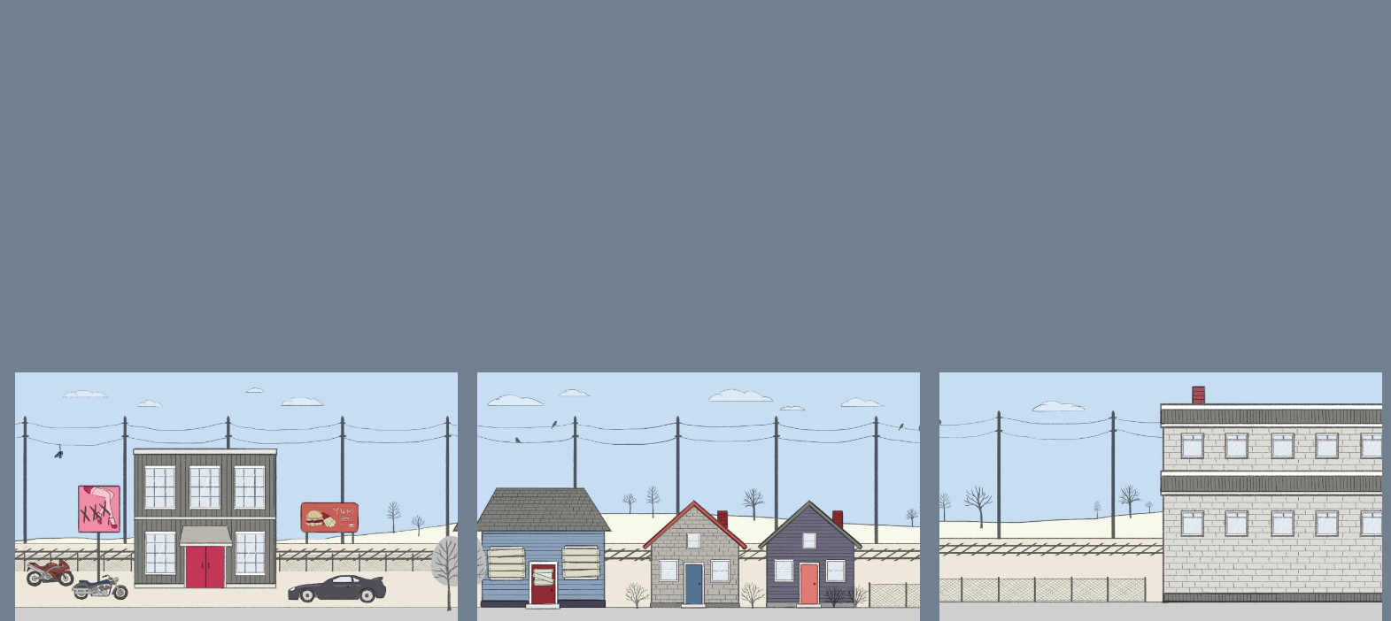
Proof of Concept - Side Scrolling
Notes:
Proof of concept of the parallax

Slide 13
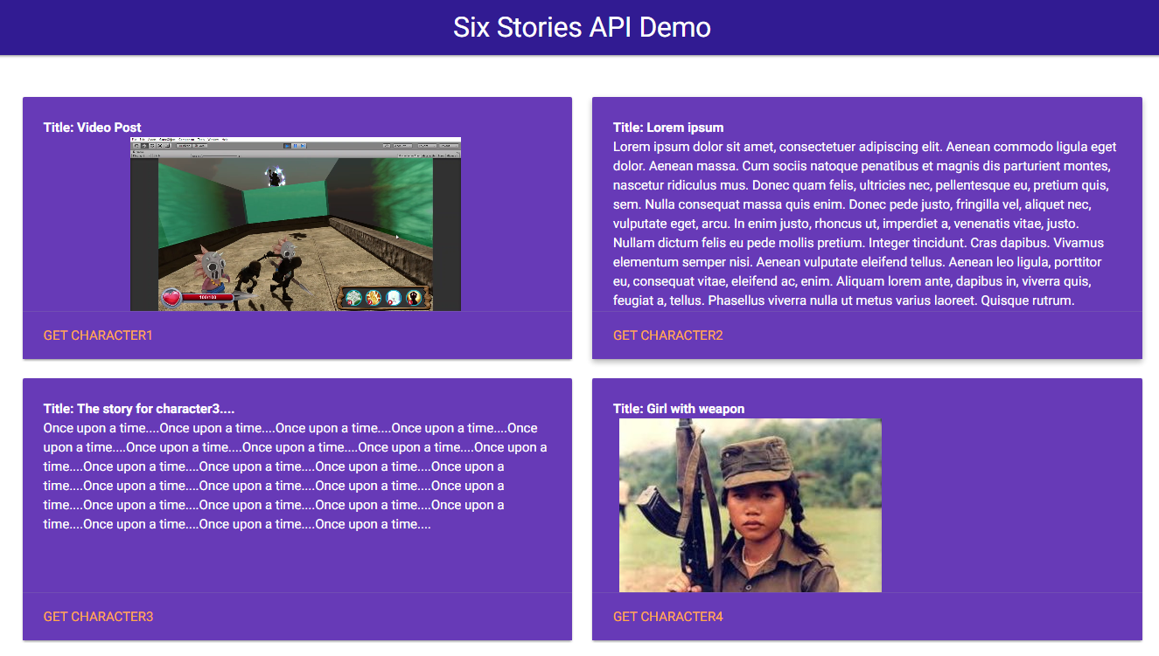
Six Stories REST API demo

Slide 14
Other Questions?

Slide 15
Thanks!!

